Slide 1
NIFTY 50 Analysis and Pair Trading
USING Time series

Slide 2
What is Time Series ?
Time series analysis is a basic tool for forecasting. Industry and government must forecast future activity to make decisions and plans to meet projected changes.
An analysis of the trend of the observations is needed to acquire an understanding of the progress of events leading to prevailing conditions.
The trend is defined as the long term underlying growth movement in a time series.
Accurate trend spotting can only be determined if the data are available for a sufficient length of time.

Slide 3
disclaimer
Forecasting does not produce definitive results. Forecasters can and do get things wrong from election results and football scores to the weather.

Slide 4
Time series examples
Sales data
Gross national product
Share prices
$A Exchange rate
Unemployment rates
Population
Foreign debt
Interest rates

Slide 5
What is Nifty 50 ? (The Case taken for Time Series Analysis)
The NIFTY 50 is a benchmark Indian stock market index that represents the weighted average of 50 of the largest Indian companies listed on the National Stock Exchange. It is one of the two main stock indices used in India, the other being the BSE SENSEX.

Slide 6
Stages in which the following analysis will be carried out:
TIME SERIES DECOMPOSITION
PREDICTIVE ANALYSIS USING TIME SERIES METHODS
PAIR TRADING ANALYSIS OF NIFTY 50 STOCKS

Slide 7
TIME SERIES decomposition
Time series decomposition is a mathematical procedure which transforms a time series into multiple different time series. The original time series is often split into 3 component series:
Seasonal: Patterns that repeat with a fixed period of time. For example, a website might receive more visits during weekends; this would produce data with a seasonality of 7 days.
Trend: The underlying trend of the metrics. A website increasing in popularity should show a general trend that goes up.
Random: Also call “noise”, “irregular” or “remainder,” this is the residuals of the original time series after the seasonal and trend series are removed.

Slide 8
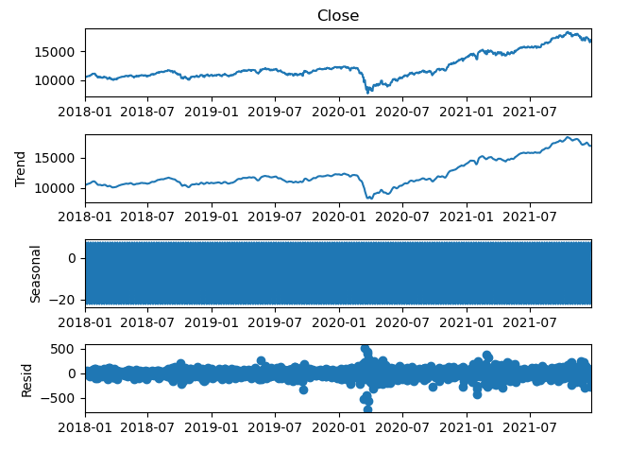
NIFTY 50 TIME SERIES DECOMPOSITION

Slide 9
OBSERVATIONS:
We can observe that Nifty 50 doesn’t follow a certain Trend as markets are unpredictable in nature.
We also can observe that there is no certain Seasonality in buying and selling of Nifty 50 because of markets being unpredicted in nature.
We can see a lot of noise in data due to sudden spike and fall in prices.

Slide 10
PREDICTIVE ANALYSIS USING TIME SERIES METHODS
In this analysis we are going to use the following 3 methods for Predictive Analysis:
SMA (SIMPLE MOVING AVERAGE)
EMA (EXPONENTIAL MOVING AVERAGE)
ARIMA

Slide 11
Simple Moving Average (SMA)
A simple moving average (SMA) is an arithmetic moving average calculated by adding recent prices and then dividing that figure by the number of time periods in the calculation average. For example, one could add the closing price of a security for a number of time periods and then divide this total by that same number of periods. Short-term averages respond quickly to changes in the price of the underlying security, while long-term averages are slower to react.
​SMA= A1​+A2​+...+An​​ / n
where: An​=the price of an asset at period, n=the number of total periods​

Slide 12
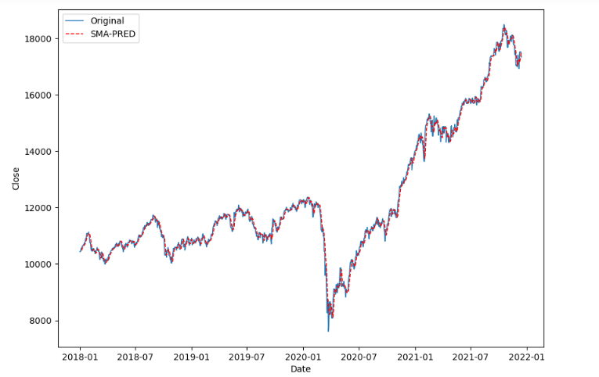
SMA affect on Nifty 50

Slide 13
Exponential Moving Average (EMA)
An exponential moving average (EMA) is a type of moving average (MA) that places a greater weight and significance on the most recent data points. The exponential moving average is also referred to as the exponentially weighted moving average. An exponentially weighted moving average reacts more significantly to recent price changes than a simple moving average (SMA), which applies an equal weight to all observations in the period.
Initial SMA: 10-period sum / 10 Multiplier: (2 / (Time periods + 1) ) = (2 / (10 + 1) ) = 0.1818 (18.18%) EMA: {Close - EMA(previous day)} x multiplier + EMA(previous day).

Slide 14
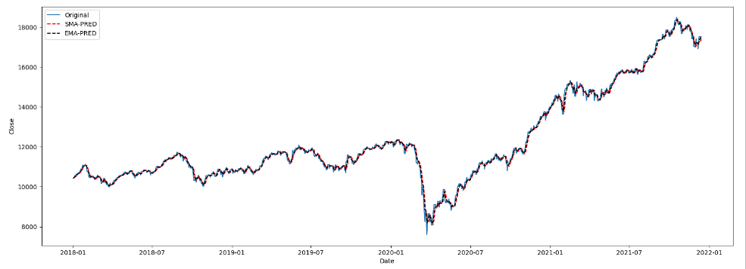
SMA/EMA affect on Nifty 50

Slide 15
Autoregressive Integrated Moving Average (ARIMA)
An autoregressive integrated moving average model is a form of regression analysis that gauges the strength of one dependent variable relative to other changing variables. The model's goal is to predict future securities or financial market moves by examining the differences between values in the series instead of through actual values.
An ARIMA model can be understood by outlining each of its components as follows:
Autoregression (AR): refers to a model that shows a changing variable that regresses on its own lagged, or prior, values.
Integrated (I): represents the differencing of raw observations to allow for the time series to become stationary (i.e., data values are replaced by the difference between the data values and the previous values).
Moving average (MA): incorporates the dependency between an observation and a residual error from a moving average model applied to lagged observations.

Slide 16
ARIMA Parameters
Each component in ARIMA functions as a parameter with a standard notation. For ARIMA models, a standard notation would be ARIMA with p, d, and q, where integer values substitute for the parameters to indicate the type of ARIMA model used. The parameters can be defined as:
p: the number of lag observations in the model; also known as the lag order.
d: the number of times that the raw observations are differenced; also known as the degree of differencing.
q: the size of the moving average window; also known as the order of the moving average.

Slide 17
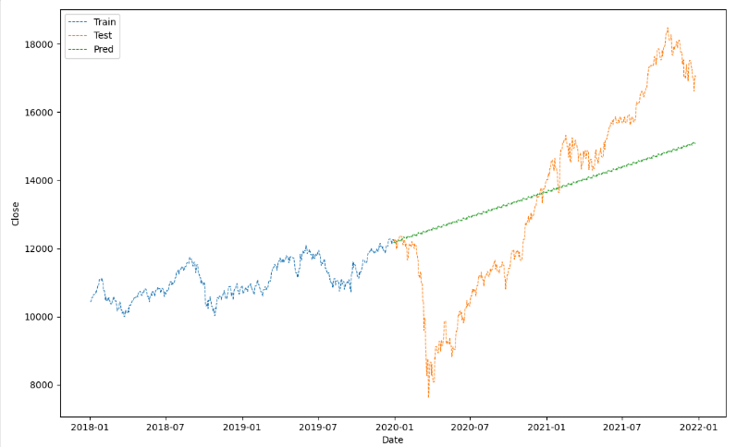
Arima affect on Nifty 50

Slide 18
PAIR TRADING ANALYSIS OF NIFTY 50 STOCKS
What Is a Pairs Trade?
A pairs trade is a trading strategy that involves matching a long position with a short position in two stocks with a high correlation.
A pairs trade strategy is based on the historical correlation of two securities. The securities in a pairs trade must have a high positive correlation, which is the primary driver behind the strategy’s profits. A pairs trade strategy is best deployed when a trader identifies a correlation discrepancy. Relying on the historical notion that the two securities will maintain a specified correlation, the pairs trade can be deployed when this correlation falters.

Slide 19
When pairs from the trade eventually deviate—as long as an investor is using a pairs trade strategy—they would seek to take a dollar matched the long position in the underperforming security and sell short the outperforming security. If the securities return to their historical correlation, a profit is made from the convergence of the prices.

Slide 20
Correlation Analysis on Nifty 50 stocks
Correlation Analysis is carried out on Nifty 50 Stocks to find stocks having the highest correlation.
From detail analysis it was found out that the highly performing correlated pair lies between 0.50 – 1.00 correlated pairs in the given.
Based on the correlated pairs we will plot the pairs to see the correlation and invest in the Pair Trading Strategy accordingly.

Slide 21
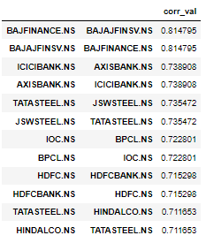
Correlated pairs found out during the Analysis

Slide 22
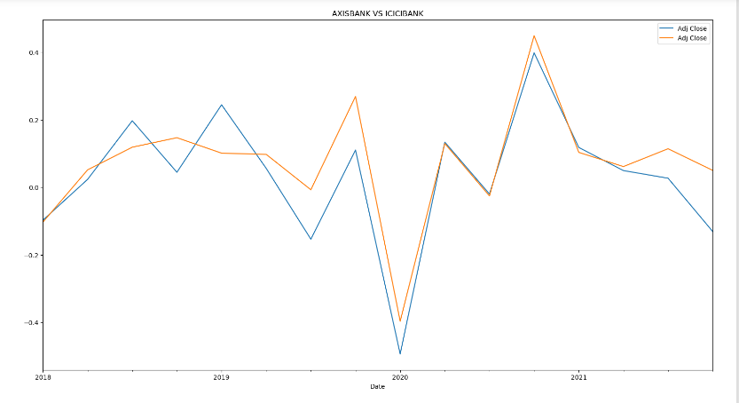
Visualization of Correlated pair for Pair trading (AXIS BANK VS ICICI BANK)

Slide 23
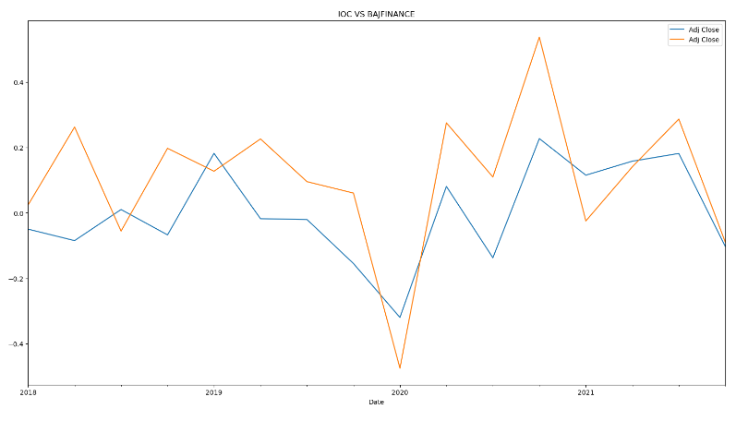
Visualization of Non-Correlated pair for Pair trading (IOC VS BAJFIANCE)

Slide 24
OBSERVATIONS:
Almost all correlated pairs are belonging to the same sector ie (Banking, Metals ,etc).
Non correlating pair don’t show the slightest convergence even in past price.

Slide 25
Hence by this we conclude our Time Series Analysis.
Thank You.

